Slide 1


Slide 2
What is important for a good future?
What do you expect from the future?
What are your plans/dreams for the future?
A good occupation / job ?
Health ?
Money ?
A nice house ?
Family ?
An expensive car ?

Slide 3
We talk about our plans/dreams with…
I will be…
I hope to be…
I hope I will be…
I guess I will be…
I’m sure I will be…
I believe I will be…
I think I will be…
I will definitely/probably be…

Slide 4
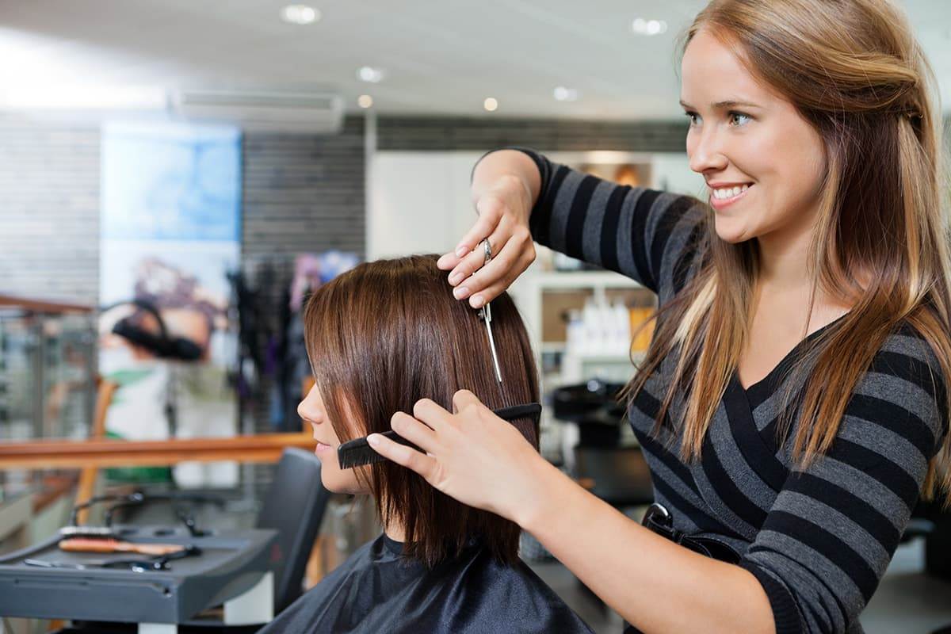
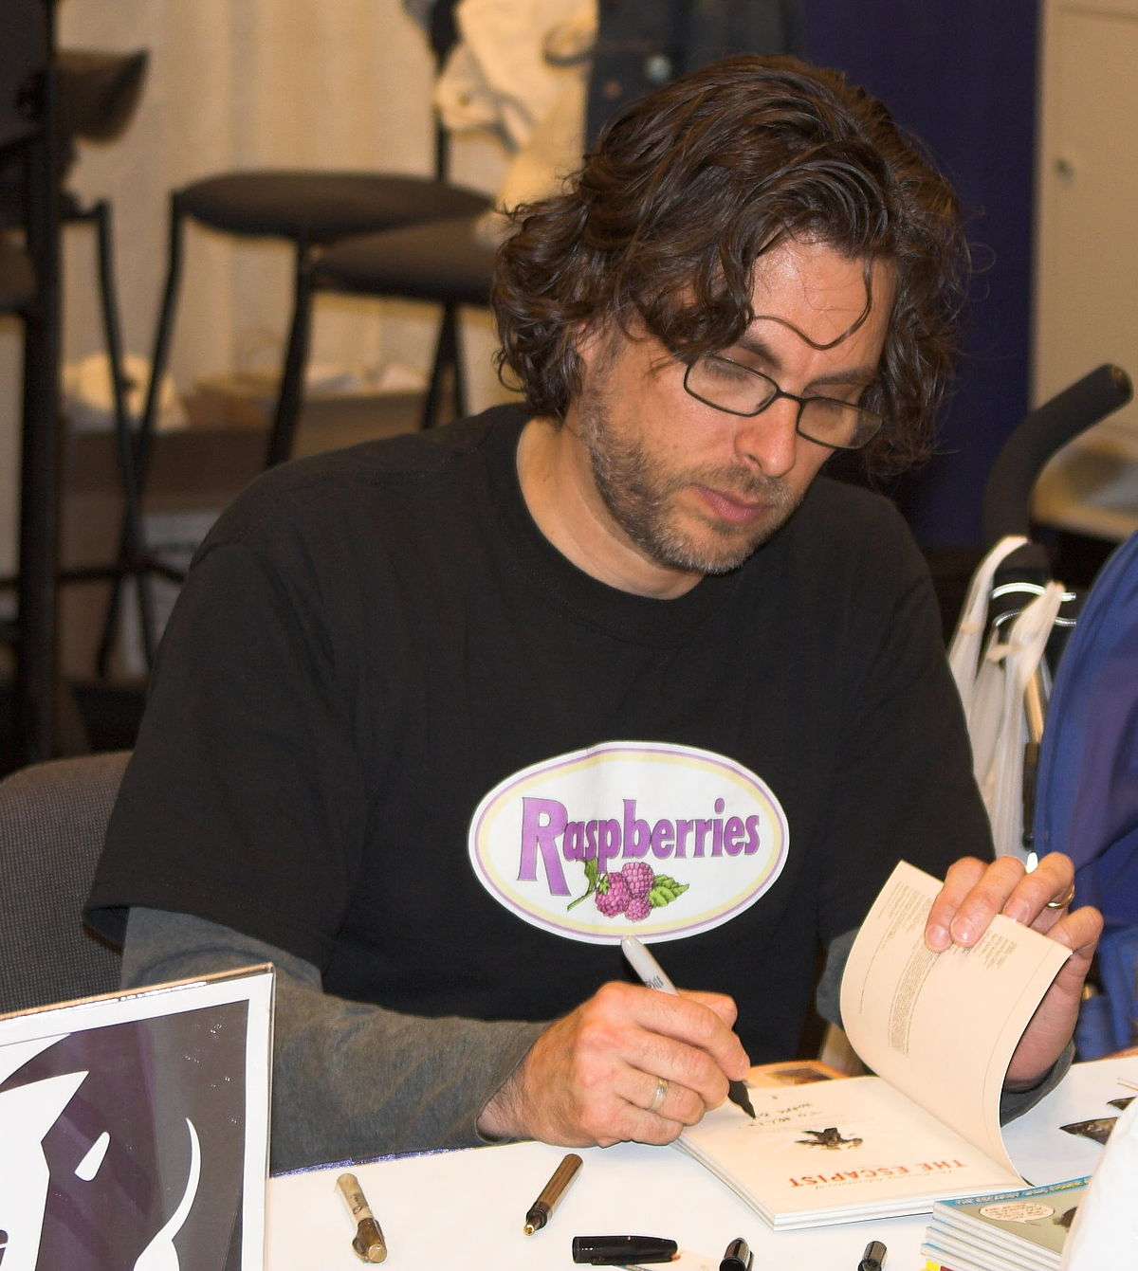
Will be
I will be a hairdresser in the future.
Martin will be a writer one day.

Slide 5
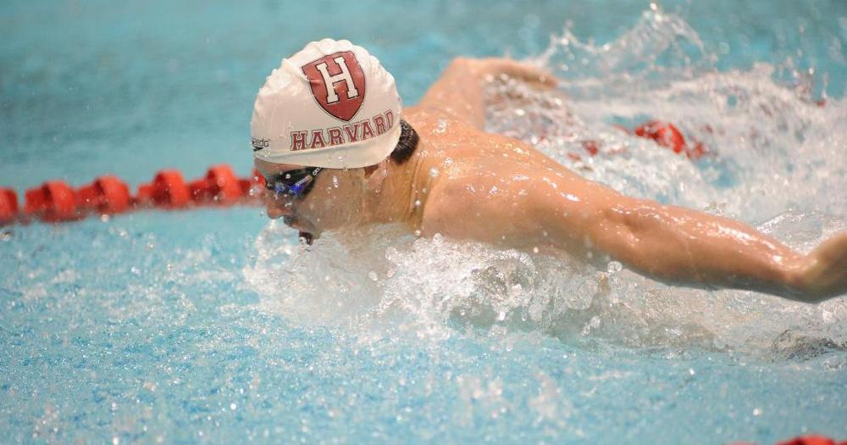
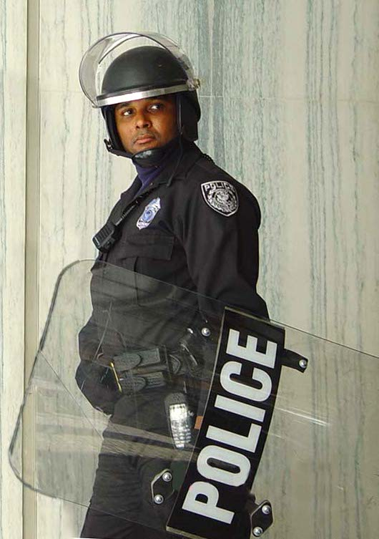
HOPE TO BE
HOPE:
Expect, wish for
I’m working hard every day, I hope to be a swimmer in the future.
Howard hopes to be a policeman soon.

Slide 6
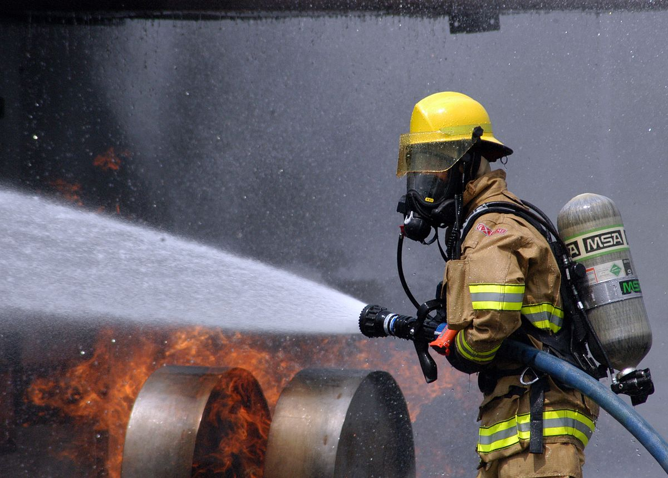
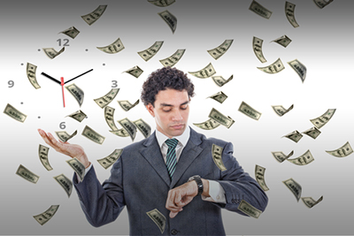
… HOPE … WILL
I hope I will be a firefighter.
Mark hopes he will be rich.

Slide 7
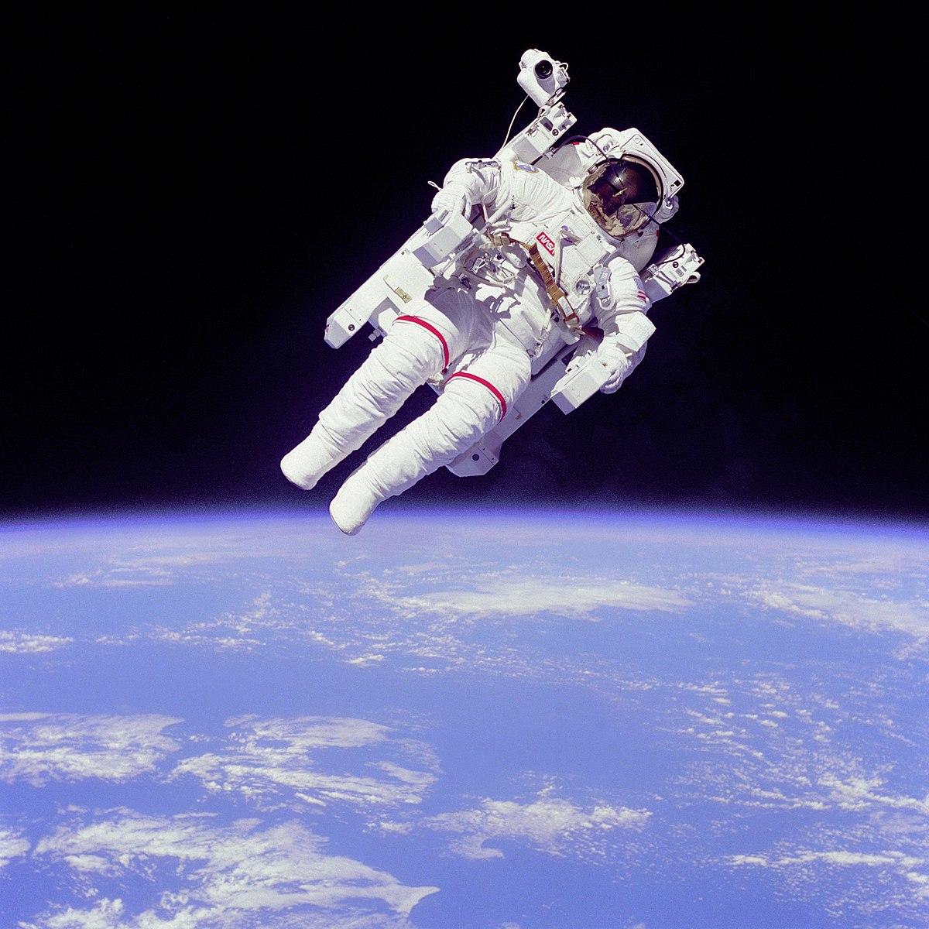
I GUESS… I THINK…
I GUESS… I THINK:
to think that something is true or possible
I guess he will be an astronaut one day.
I think he will be an astronaut one day.

Slide 8
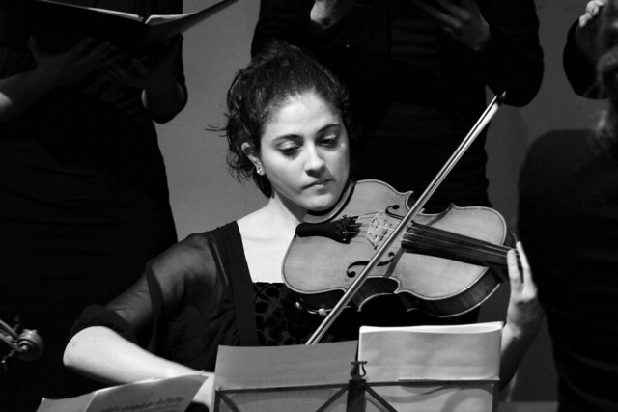
I’M sure … will…
I’M SURE:
You know something will happen, definitely %100.
Sue plays violin really well. I’m sure she will be a good musician.
Sue: I’m sure I will be a good musician one day.

Slide 9
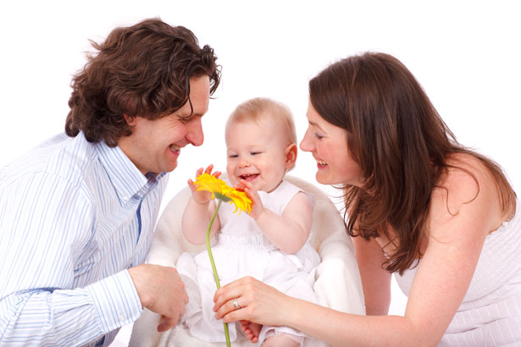
I BELIEVE…
BELIEVE:
to suppose that something is true or likely
I believe I will have a nice family some day.

Slide 10
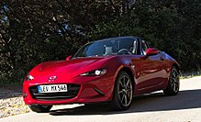
Definitely / probably
DEFINITELY:
Something will happen for sure
PROBABLY:
something is likely to happen
I will definitely have a sports car one day.
I will probably have a sports car when I’m rich.

